Slide 1
Guided Capestone Big Mountain Resort
Presentation--sada

Slide 2
Problem Identification
Big Mountain Resort needs to find ways to select a better value of their ticket prices to balance the increased operating costs of chair lift by $1,540,000 (preferably end of this season).
Estimated crowd for a year is 350,000
We need to increase the ticket cost/ Need to invite more crowd
We need to increase the ticket cost by $4.4
Need to increase operation hours/ Days/ Extending working holidays
Heavy storms may affect the season
Increasing cost may not be welcome visitors
Not sure about the visitor count

Slide 3
Recommendation and key findings
The solution for the business problem was a general one of modeling resort revenue.
Using our machine learning model to gain insight into what Big Mountain’s ideal ticket price could be, and how that might change under various scenarios.
Permanently closing down up to 10 of the least used runs.
Increase the vertical drop by adding a run to a point 150 feet lower down but requiring the installation of an additional chair lift to bring skiers back up, without additional snow making coverage.
Adding 2 acres of snow making cover.
Increase the longest run by 0.2 mile to boast 3.5 miles length requiring an additional snow making coverage of 4 acres.

Slide 4
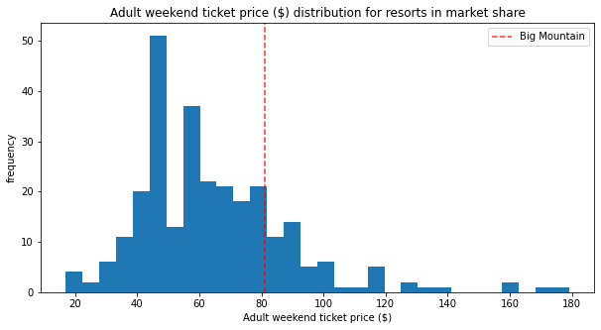
Modeling results and analysis – Ticket price

Slide 5
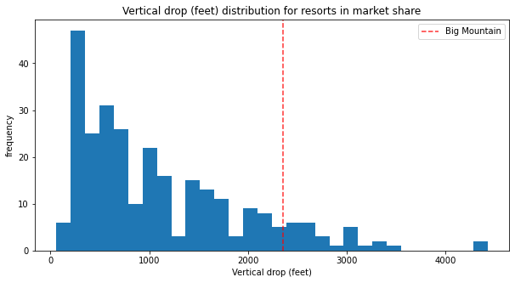
Vertical drop

Slide 6
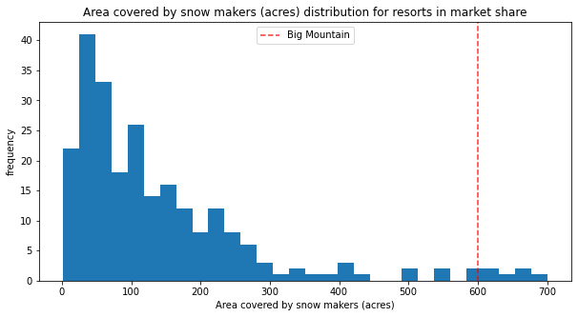
Snow Making area

Slide 7
Summary and Conclusion
Big Mountain Resort needs to find ways to select a better value of their ticket prices to balance the increased operating costs of chair lift by $1,540,000 (preferably end of this season).
Permanently closing down up to 10 of the least used runs.
Increase the vertical drop by adding a run to a point 150 feet lower down but requiring the installation of an additional chair lift to bring skiers back up, without additional snow making coverage.
Adding 2 acres of snow making cover.
Increase the longest run by 0.2 mile to boast 3.5 miles length requiring an additional snow making coverage of 4 acres

